Slide 1
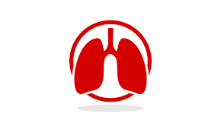
University of Basrah AlZahraa Medical College
Respiratory Failure
Respiratory system module Academic year 2022-2023 (2^{ed} year)
Session 10 Lecture 2
Dr. Nehaya Mnahi [Module leader]
Dr. Hadeel Salman [Module co-leader]
Dr. Ahmed Bader
Dr. Ahmed Dawii
Dr. Nawal Mustafa
Dr. Ameer Qassim
Dr. Zuhair Abdul Kareem
Dr. Dr.Mustafa Emad

Slide 2
Learning Objectives
By the end of lecture you should know
Respiratory failure definition
The types of respiratory failure and the difference between each
Common causes of each types
The headline management of each types

Slide 3
Respiratory Failure Definition
The term ‘Respiratory Failure’ is used when pulmonary gas exchange fails to maintain normal arterial oxygen and carbon dioxide levels
Its classification into types I and II is defined by the absence or presence of hypercapnia (raised PaCO2)

Slide 4
When disease impairs ventilation (e.g. in asthma or pneumonia), perfusion of that region results in hypoxic and CO2- laden blood entering the pulmonary veins
Increased ventilation of neighbouring regions of normal lung can increase CO2 excretion, correcting arterial CO2 to normal, but cannot augment oxygen uptake because the haemoglobin flowing through these normal regions is already fully saturated

Slide 5
Type 1 Respiratory Failure
Admixture of blood from the under-ventilated and normal regions thus results in hypoxia with Normocapnia
Diseases causing this include all those that impair ventilation locally with sparing of other regions such as
Acute asthma
Pulmonary Oedema
Lobar collapse
Pneumothorax
Pneumonia
Pulmonary Embolism

Slide 6
Type 2 Respiratory Failure
Arterial hypoxia with hypercapnia is seen in conditions that cause widespread, severe ventilation– perfusion mismatch, leaving insufficient normal lung to correct PaCO2, or any disease that reduces total ventilation
This type of respiratory failure caused not only by diseases of the lung but also disorders affecting any part of the neuromuscular mechanism of ventilation

Slide 7
Type 1 Respiratory Failure vs. Type 2 Respiratory Failure

Slide 8
Management of Acute Respiratory Failure
Prompt diagnosis and management of the underlying cause
In type I respiratory failure, high concentrations of oxygen (40–60% by mask)
Mechanical ventilation
Notes:
*will usually relieve hypoxia by increasing the alveolar PO2 in poorly ventilated lung units **e.g. severe pneumonia affecting several lobes may be needed to relieve hypoxia Patients who need high concentrations of oxygen for more than a few hours should receive humidified oxygen

Slide 9
Oxygen therapy in patients with Respiratory Failure
A small percentage of patients with severe chronic COPD and type II respiratory failure develop abnormal tolerance to raised PaCO2 and may become dependent on hypoxic drive to breathe
In these patients only, lower concentrations of oxygen (24–28% by Venturi mask) should be used to avoid producing worsening respiratory depression

Slide 10
Venturi Mask for delivery of controlled Oxygen therapy

Slide 11
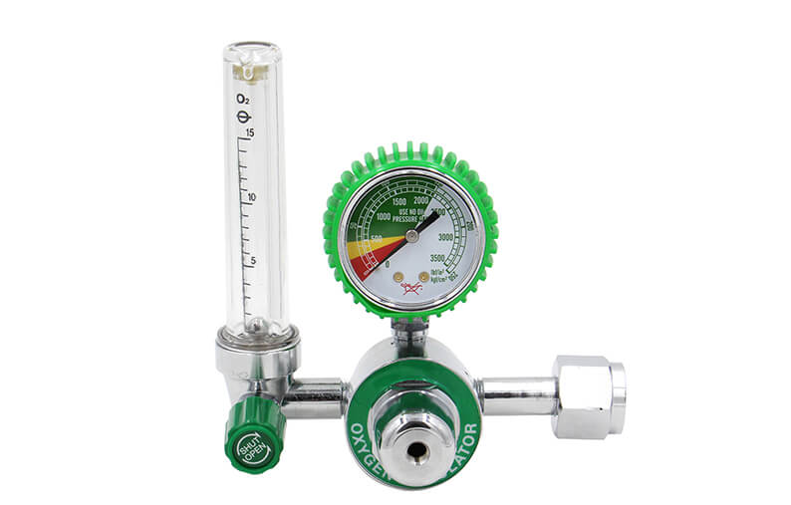
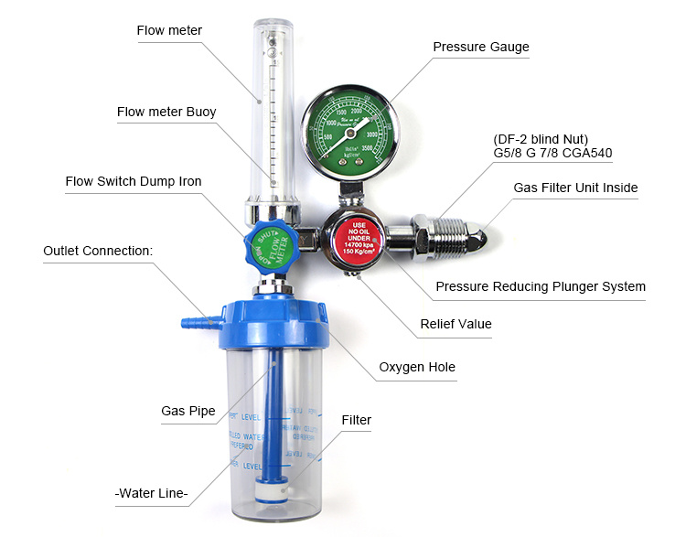
Regular Oxygen delivery system
Notes:
Oxygen Regulator

Slide 12
Patients with acute type II respiratory failure who have reduced drive or conscious level may be suffering from
Poisoning
CO2 Narcosis
Primary failure of neurological drive (ICH or head injury)
History from a witness may be helpful, and reversal of specific drugs with (for example opiate antagonists) is occasionally successful, but should not delay intubation and supported mechanical ventilation in appropriate cases

Slide 13
Chronic and ‘Acute on Chronic’ Type II Respiratory Failure
The most common cause of chronic type II respiratory failure is severe COPD & Although PaCO2 may be persistently raised, there is no persisting acidaemia because the kidneys retain bicarbonate, correcting arterial pH to normal
This ‘compensated’ pattern’*is maintained until there is a further acute illness such as an exacerbation of COPD that precipitates an episode of ‘acute on chronic’ respiratory failure, with acidaemia and initial respiratory distress followed by drowsiness and eventually coma
Notes:
which may also occur in chronic neuromuscular disease or kyphoscoliosis

Slide 14
These patients have lost their chemo sensitivity to elevated PaCO2, and so they may paradoxically depend on hypoxia for respiratory drive and are at risk of respiratory depression if given high concentrations of oxygen, e.g. during ambulance transfers or in emergency departments
in contrast to acute severe asthma, some patients with ‘acute on chronic’ type II respiratory failure due to COPD may not appear distressed, despite being critically ill so physical examination is of value in looking for physical sign of CO2 retention

Slide 16
Management of Chronic ‘Acute on Chronic’ Respiratory Failure
Maintenance of airway
Treatment of specific precipitating cause
Frequent physiotherapy ‡ pharyngeal suction
Nebulised bronchodilators
Controlled oxygen therapy(24% Venturi mask )
(Aim for a Pa0, > 7 kPa (52 mmHg) (a Pa0, < 5 kPa (37 mmHg) is dangerous)
Antibiotics if evidence of infection
Diuretics if evidence of fluid overload
Progress
If PaCO continues to rise or a safe PaO2 cannot be achieved without severe hypercapnia and acidaemia, mechanical ventilator may be required

Slide 17
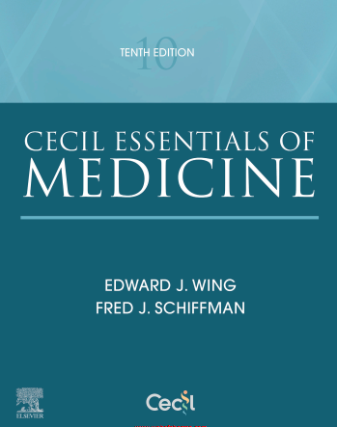
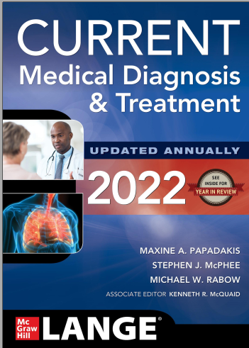
References
Davidson’s Principles and practice of medicine 23rd edition
Cecil essential of Medicine tenth edition
Current Medical diagnosis and treatment 2022

